Slide 1
Data Communication
Assignment #2
Use PPPoe and analysis the PPPoe Frame

Slide 2
1
PPPoe (PPP over Ethernet) Definition
PPPoE is a network configuration used for establishing a PPP connection over an Ethernet protocol.
It is commonly used for creating DSL Internet connections.
Since DSL modems typically connect to computers via an Ethernet connection, a standard dial-up PPP connection cannot be used.
Therefore, PPP over Ethernet allows computers to connect to an Internet service provider (ISP) via a DSL modem.
Notes:
.

Slide 3
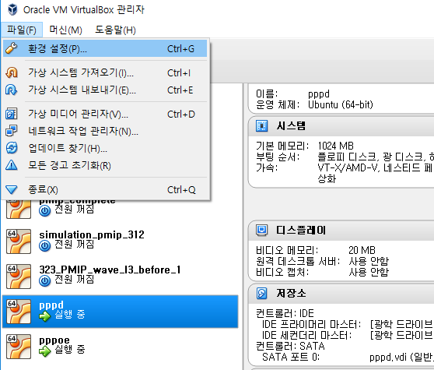
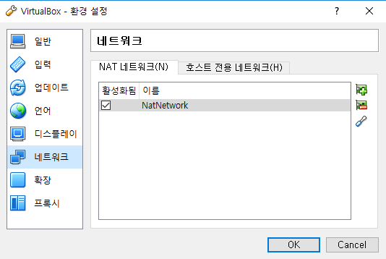
2
PPPoe (PPP over Ethernet) Setting
Install 2 virtual machines with Ubuntu 12.04.05
Virtual Machine #1 (VM1) will be the PPPoe Server and
Virtual Machine #2 (VM2) will be the PPPoe Client
2. Then, go to Preferences (환경 설정)
3. Go to Network
Notes:
.

Slide 4
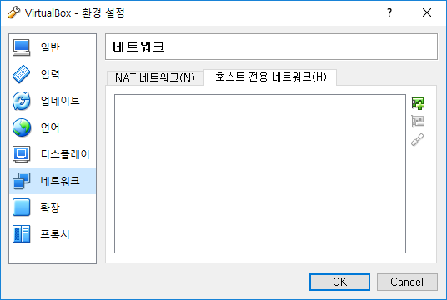
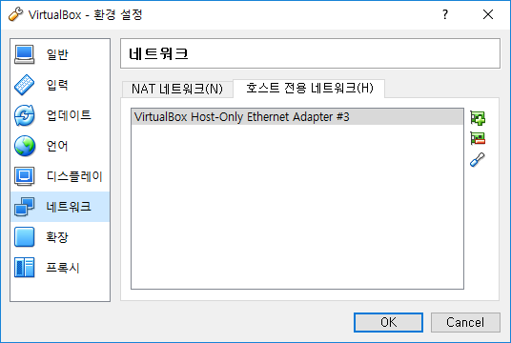
2
PPPoe (PPP over Ethernet) Setting
Select the host only network, and adds the network
Notes:
.

Slide 5
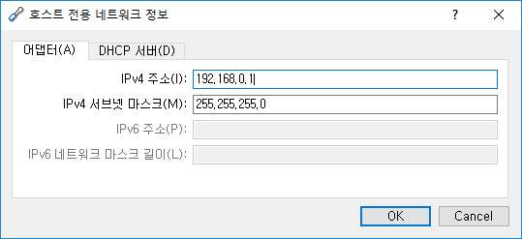
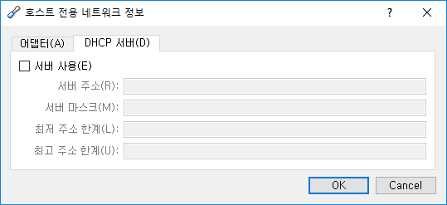
2
PPPoe (PPP over Ethernet) Setting
Edit the host only network configuration
(In my case, I use 192.168.0.1)
(Do not check “Using DHCP server”
Notes:
.

Slide 6
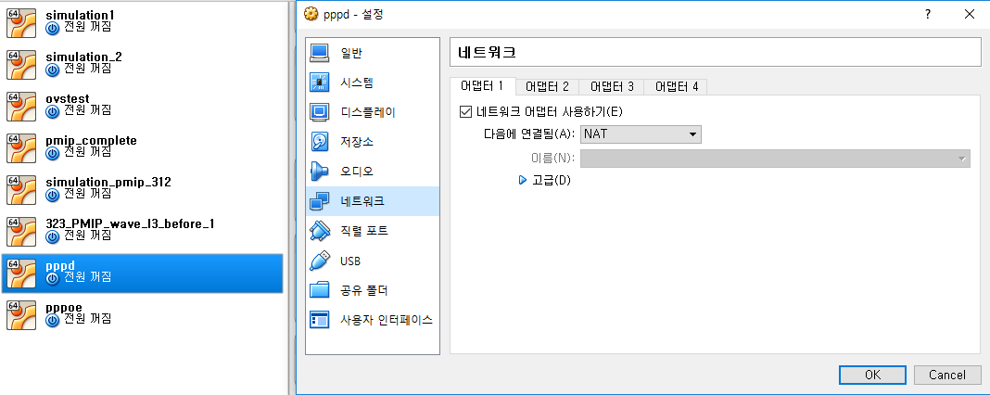
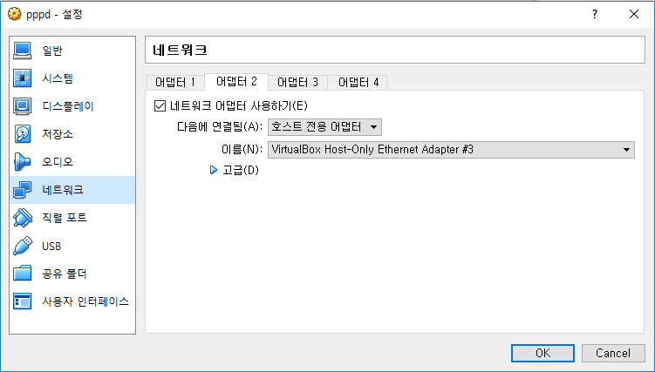
2
PPPoe (PPP over Ethernet) Setting
Set up network part of two virtual machines equally
6-1) First interface : NAT
6-2) Second interface : Host only Adapter
Notes:
.

Slide 7
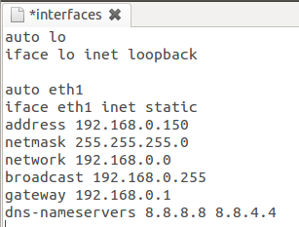
2
PPPoe (PPP over Ethernet) Setting
7. Configure VM1 eth1 IP address
Command : gedit /etc/network/interfaces
Setting Dns address :
Command : echo “nameserver 8.8.8.8” > /etc/resolv.conf
(8.8.8.8 means google’s Dns)
192.168.0.150 (Any address ok, but the prefix for this address must follow the pool of addresses previously set in the virtualbox preference)
Prefix
Notes:
. (Any address ok, but the prefix for this address must follow the pool of addresses previously set in the virtualbox preference)

Slide 8

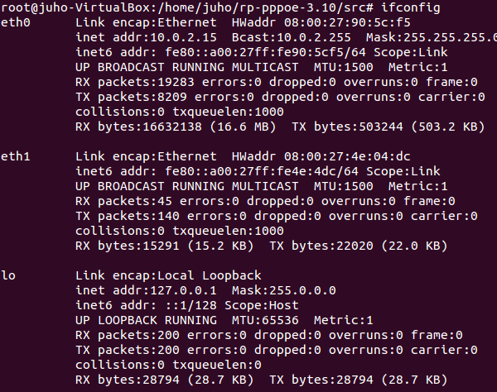
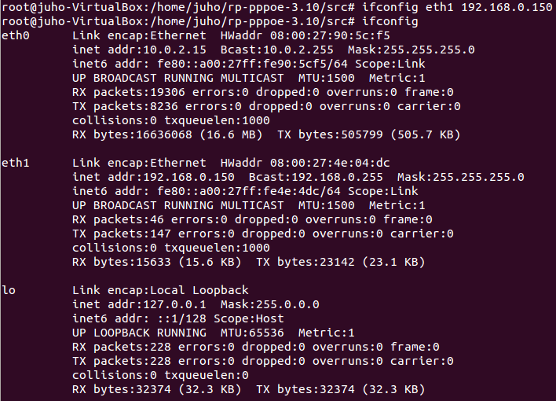
2
PPPoe (PPP over Ethernet) Setting
7. network restart : service network-manager restart
ifdown eth1 & ipup eth1
Notes:
. (Any address ok, but the prefix for this address must follow the pool of addresses previously set in the virtualbox preference)

Slide 9
2
PPPoe (PPP over Ethernet) Setting
8. Install Some programs on two virtual machines terminal
(Installation is only possible with root privileges)
1) apt-get install wireshark
2) apt-get install pppoe
3) apt-get install ppp
Notes:
.

Slide 10
2
PPPoe (PPP over Ethernet) Setting
VM 1 Setting
9-1) Download rp-pppoe : It is necessary for VM1 to function as a PPPoE server.
(Download command)
wget http://www.roaringpenguin.com/files/download/rp-pppoe-3.10.tar.gz
9-2) Decompress the rp-ppope file
(Command)
tar -zxvf rp-pppoe-3.10.tar.gz
9-3) Go to decompressed file -> src file
(Command)
cd rp-pppoe-3.10/src
Notes:
.

Slide 11
2
PPPoe (PPP over Ethernet) Setting
VM 1 Setting
9-4) Configure and install
(Command) : ./configure
(Command) : make && make install
VM 2 Setting : No settings like VM1 are needed.
10-1) But, Eth1 IP address setting is still necessary.
Notes:
.

Slide 12

2
PPPoe (PPP over Ethernet) Setting
VM1 PPPoe server secret setting
Command : gedit /etc/ppp/chap-secrets
client : any name ok
server : *
secret : any secret string ok
IP address : *
Notes:
.

Slide 13
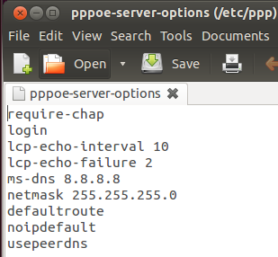
2
PPPoe (PPP over Ethernet) Setting
VM1 PPPoe server secret setting
Command : gedit /etc/ppp/pppoe-server-options
Command : echo "192.168.0.150-170" > /etc/ppp/allip
This will assign the future clients one IP address from the 192.168.0.150 until 192.168.0.170 range.
Notes:
.

Slide 14
3
PPPoe (PPP over Ethernet) operation
1. VM1 :
1-1) Command : pppoe-server -F -I eth1 -C juho -L 10.0.0.1 -p /etc/ppp/allip
F means that the server is operated as a daemon
I means that the interface on which PPPoe is run
C means that the access concentrator name of the server
L means that the local IP address. (This is passed to spawned pppd processes.)
Notes:
.

Slide 15
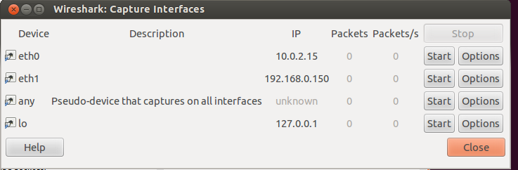
3
PPPoe (PPP over Ethernet) operation
1. VM1 :
1-2) Run wireshark and select eth1
Notes:
.

Slide 16
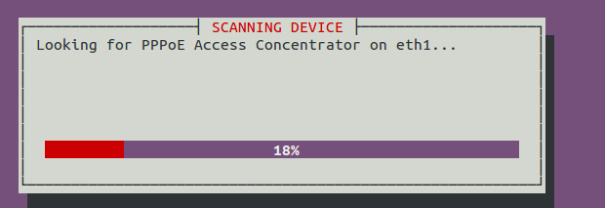
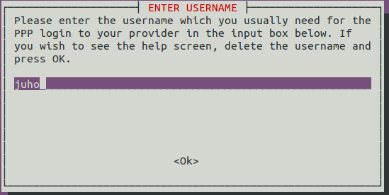
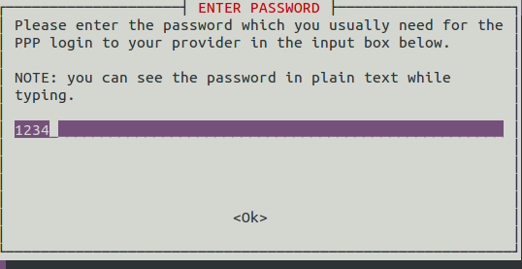
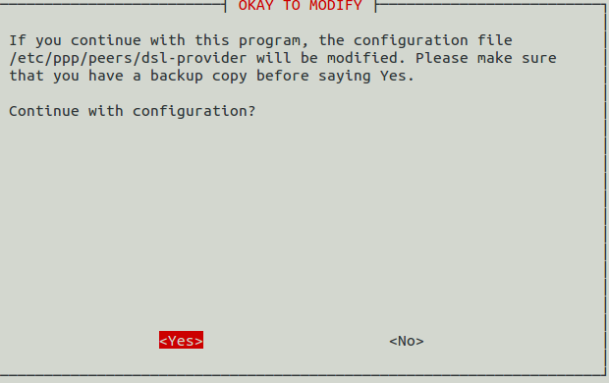
3
PPPoe (PPP over Ethernet) operation
2. VM2 :
2-1) Run PPPoe (Command : pppoeconf) and insert userid and p/w
“Yes” in all other windows

Slide 17
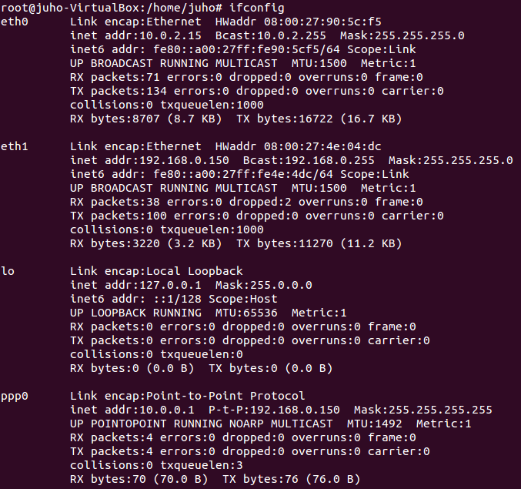
4
PPPoe (PPP over Ethernet) operation result
1. VM1 : Command : ifconfig
Notes:
.

Slide 18
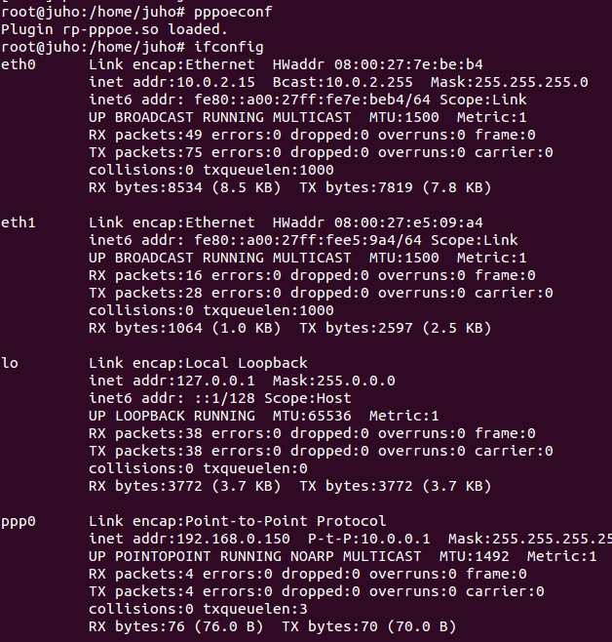
4
PPPoe (PPP over Ethernet) operation result
2. VM2 : Command : ifconfig
Notes:
.

Slide 19
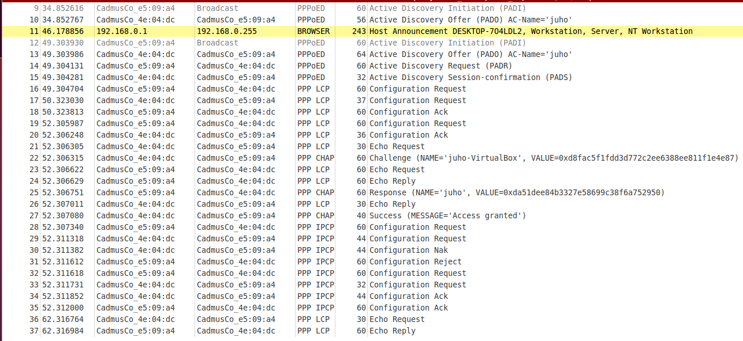
4
PPPoe (PPP over Ethernet) operation result
3. Wireshark screen
Notes:
.

Slide 20

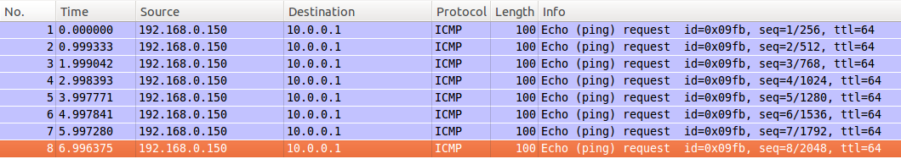
4
PPPoe (PPP over Ethernet) operation result
4. Ping from VM2 to VM1
VM2 : Command : ping 10.0.0.1
VM1’s Wireshark packet capture screen

Slide 21
5
과제 requirement
PPPoe packet frame analysis
1차 과제의 PPP와 여기서의 PPP connection frame 간의 차이점 기술
1차 과제에서의 ping을 보냈을 때의 패킷과 여기서 ping을 보냈을 때의 패킷 간의 차이점 기술
VM3을 새로 install 한 뒤, VM1 PPPoe Server와 추가적인 ppp connection을 맺는 것을 해보고,
4-2 : VM1 <-> VM3 간의 Ping 패킷과
4-3 : VM2 <-> VM3 (no ppp connection) 간의 Ping 패킷의 차이점이 있는지 확인 후, 차이점이 있다면 기술.
제출 사항 : 1) 각각의 요구사항에 대한 pcap 파일 (wireshark 저장 파일)
2) 각각의 요구사항에 대한 스크린샷을 동반한 상세한 기술
Notes:
.

